Slide 1
Medium-Sized Switched Network Construction
Implementing VLANs and Trunks
Notes:
Thực hiện Xây dựng mạng Medium-Sized Switched

Slide 2
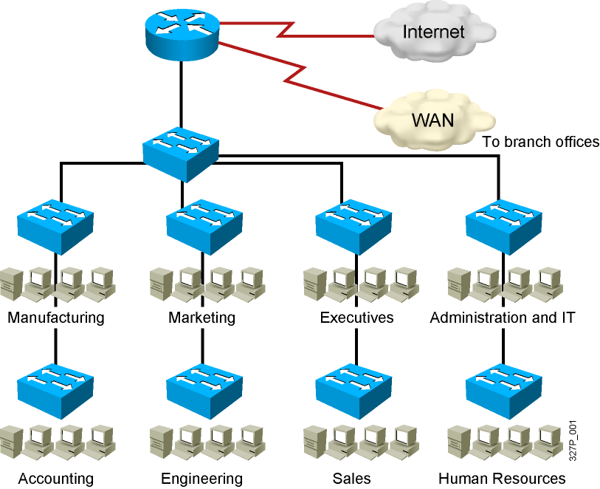
Issues in a Poorly Designed Network
Lưu lượng quảng bá (broadcast traffic) trong mạng LAN của bạn quá lớ
Các nhóm làm việc cần gia tăng bảo mật hoặc bị làm chậm vì quá nhiều bản tin quảng bá.
Các nhóm làm việc cần nằm trên cùng một miền quảng bá vì họ đang dùng chung các ứng dụng.
Hoặc chỉ để chuyển đổi một switch đơn thành nhiều switch ảo.
Notes:
Các vấn đề trong một mạng kém thiết kế
Không giới hạn quản lý đuoc vung quảng bá
Vùng phát broadcast lớn
Tạo ra một vùng lớn unicast traffic dẩn đến không quản lý được mac

Slide 3
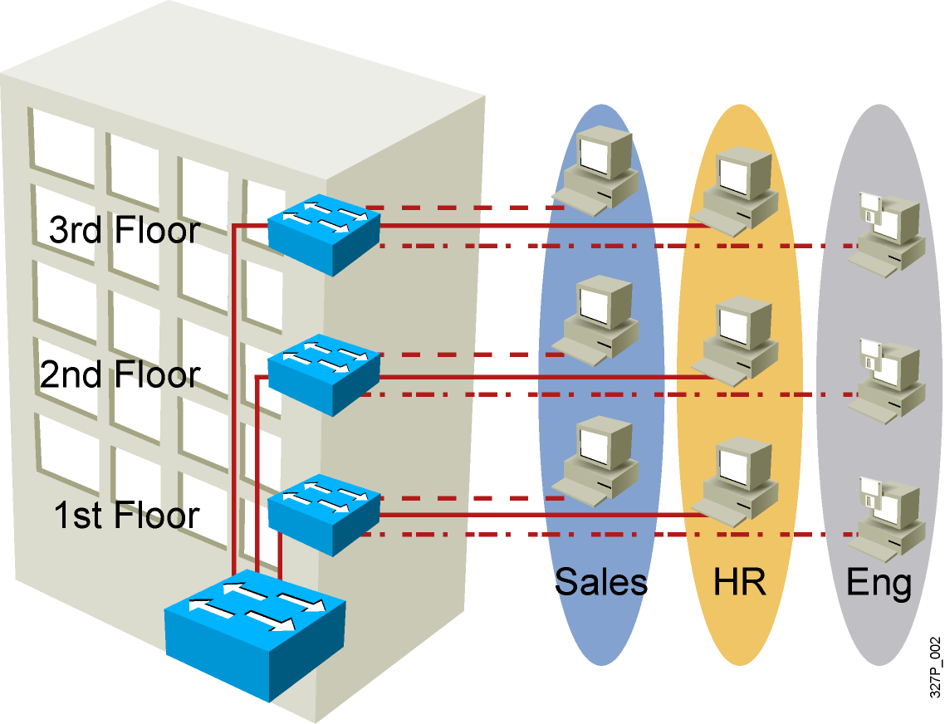
VLAN Overview
Segmentation
Flexibility
Security
VLAN = Broadcast Domain = Logical Network (Subnet)
Notes:
Phân đoạn mạng nhỏ hơn
Tính linh hoạt
Đảm bảo an ninh
Emphasize: A VLAN is a broadcast domain.
Note: In order to have inter-VLAN communications, a router is required.

Slide 4
Why Designing VLANs
Tiết kiệm băng thông của hệ thống mạng.
Quản lý vùng broadcast domain.
Tăng khả năng bảo mật.
Dễ dàng thêm hay bớt máy tính vào VLAN.
Giúp mạng có tính linh động cao.
Notes:
Việc đi vào thiết kế một hệ thống vlan chúng ta cần phải thực hiện việc khảo sát mô hình mạng của hệ htống một cách chi tiết và cần thiết kế một cách bài bản theo mô hình phân cấp
Dễ quản lý và xử lý sự cố
Hạn chế tối đa các lỗi
Giảm số mục bảng định tuyến

Slide 5
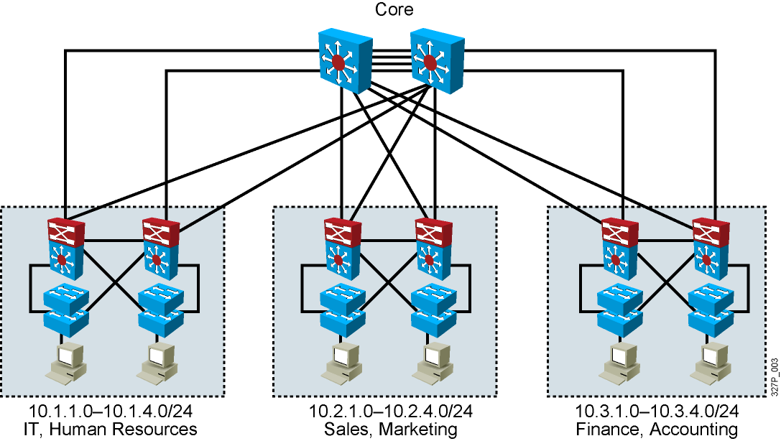
Guidelines for Applying IP Address Space
Allocate one IP subnet per VLAN.
Allocate IP address spaces in contiguous blocks.
Notes:
Việc gán áp dụng Địa chỉ không gian địa chỉ ip cho vlan
Phân bổ một subnet IP cho mỗi VLAN.
Phân bổ không gian địa chỉ IP trong khối tiếp giáp.

Slide 6
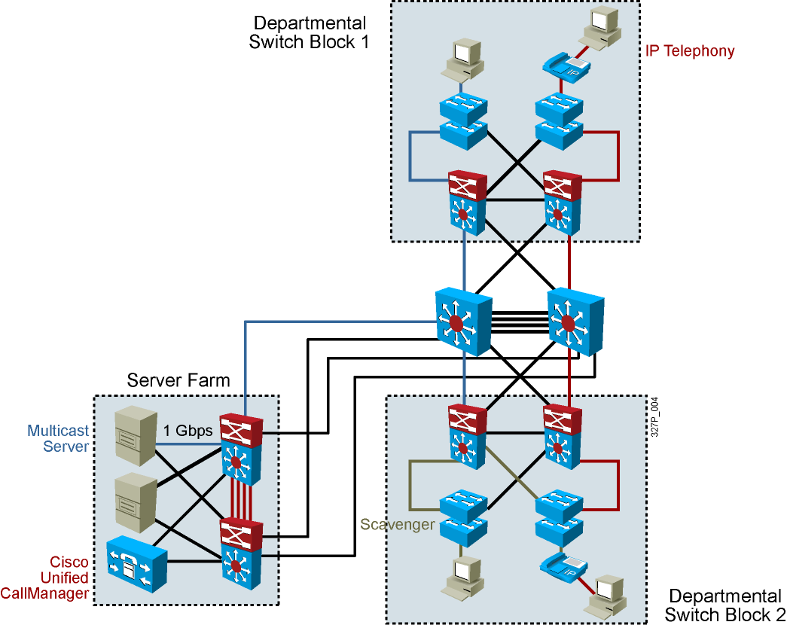
Network Traffic Types
Traffic types to consider when designating VLANs:
Network management
IP telephony
IP Multicast
Normal data
Scavenger class
Notes:
Traffic types to consider when designating VLANs:
Network management
IP telephony
IP Multicast
Normal data
Scavenger class: Scavenger class is intended for undesirable traffic (i.e., virus, worms, etc.) and non-productive or employee-distracting applications. We used to be able to include bit-torrent traffic and social networking web sites in this, but bit-torrents are becoming common for downloading large files (e.g., Linux distributions), and many companies use social networking sites (Facebook, YouTube, Linked-in, etc.) for marketing and support information.
Lớp Scavenger là dành cho giao thông không mong muốn (tức là, virus, sâu, vv) và các ứng dụng phi sản xuất hoặc nhân viên mất tập trung. Chúng tôi sử dụng để có thể bao gồm giao thông bit-torrent và các trang web mạng xã hội trong việc này, nhưng bit-torrent đang trở nên phổ biến để tải về các tập tin lớn (ví dụ, các bản phân phối Linux), và nhiều công ty sử dụng các trang web mạng xã hội (Facebook, YouTube, Liên Kết -in, vv) để tiếp thị và hỗ trợ thông tin.

Slide 7
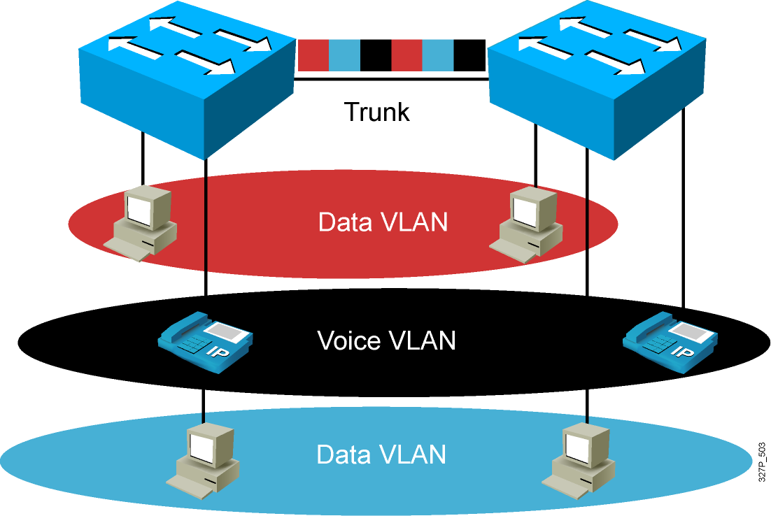
VLAN Operation

Slide 8
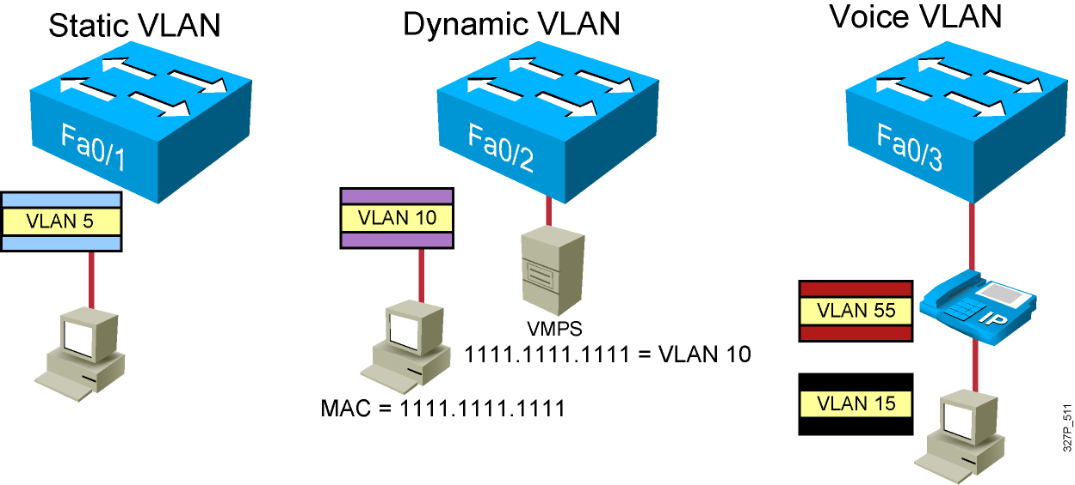
VLAN Membership Modes
Notes:
Note: Once a port has been assigned to a VLAN, it cannot send or receive traffic from devices in another VLAN without the intervention of a Layer 3 device like a router.
The 1900 can’t be configure as the VMPS.
A CiscoWorks 2000 or CWSI management station or a Catalyst 5000 switch can be configured as the VMPS.
In the future, dynamic VLANs may also offer membership based on other criteria such as protocol or application. Dynamic VLANs are covered in the Managing Cisco Switched Internetworks class.

Slide 9
VLAN Membership Modes
Static VLAN
Dynamic VLAN
Trunk
ISL
Port e0/4
Port e0/9
IEEE 802.1Q
VLAN5
VLAN10
VMPS
1111.1111.1111 = vlan 10
MAC = 1111.1111.1111
Notes:
Slide 1 of 1
Purpose:
Emphasize:
Note:
Once a port has been assigned to a VLAN, it can not send or receive traffic from devices in another VLAN without the intervention of a layer 3 device like a router.
The 1900 can’t be configure as the VMPS.
A CiscoWorks 2000 or CWSI management station or a Cat 5000 switch can be configured as the VMPS.
In the future, dynamic VLANs may also offer membership based on other criteria such as protocol or application. Dynamic VLANs are covered in the Managing Cisco Switched Internetworks class.

Slide 10
ENCAPSULATION
ISL (Inter-Switch Link)Tagging
IEEE 802.1Q

Slide 11
ISL (Inter-Switch Link)Tagging
ISL trunks enable VLANs across a backbone
Performed with ASIC (Application-specific Integrated Circuit)
Not intrusive to client stations, client does not see the ISL header
Effective between switches, routers and switches, switches and servers with ISL network interface cards
VLAN Tag added by incoming port
Inter-Switch Link carries VLAN identifier
VLAN Tag stripped by forwarding port
Notes:
Slide 1 of 1
Purpose:
Emphasize:
Note:
The 1900 only supports ISL trunking.
ISL is Cisco Proprietary. 802.1Q is an IEEE standard.
Other trunk types:
LANE (VLANSs over ATM)
802.10 (FDDI trunk)
Tối ưu các tính hiệu truyền giữ các chương trình ứng dụng bằng cách nhóm chúng lại theo từng vlanID
Từ đó tránh được việc các client khác tiếp nhận sử lý ác tính hiệu không phải gửi cho mình các client cũng không cần biết sự tồn tại của ISL header
Như vậy tính hiệu quả thể hiện việc truyền tính hiệu giữa các switch, và truyền thông swich → ruoter và switches and servers

Slide 12
ISL Encapsulation
Cyclic Redundancy Check
ISL Header
26 bytes
Encapsulated Ethernet frame
CRC
4 bytes
DA
Type
User
SA
LEN
AAAA03
HSA
VLAN
BPDU
INDEX
RES
BPDU
VLAN
BPDU
Frames encapsulated with ISL header and CRC
Support for many VLANs (1024)
VLAN field
BPDU bit
Notes:
Slide 1 of 1
Purpose:
Emphasize:
Note:
Since ISL technology is implemented in ASICs, frames are tagged at wire speed.
The number of VLANs supported by a switch depends on the switch hardware.
The Catalyst 1900en supports 64 active VLANs with an instance of STP per VLAN.
PVST = Per VLAN Spanning Tree. PVST is a Cisco proprietary implementation. It requires Cisco ISL encapsulation in order to work.

Slide 13
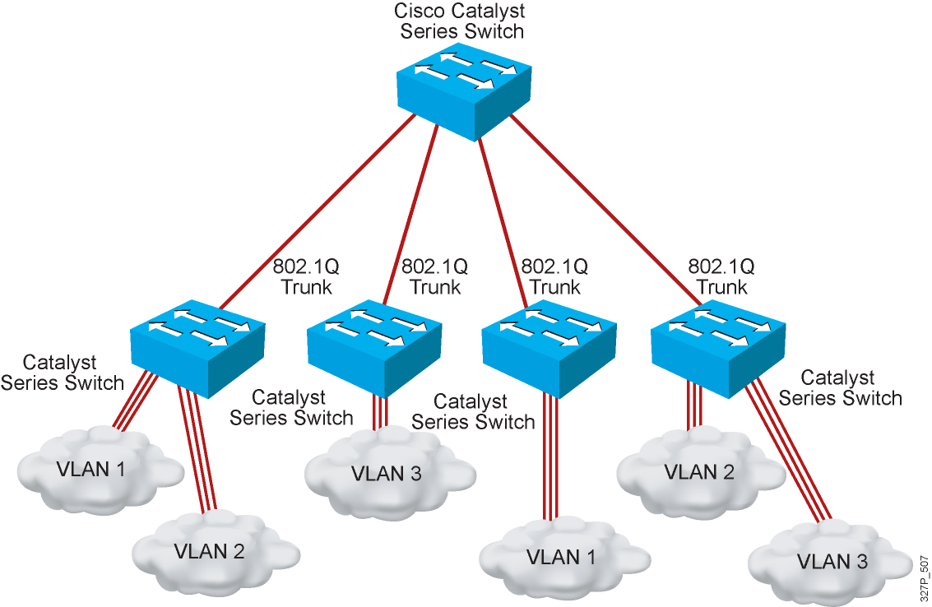
802.1Q Trunking

Slide 14
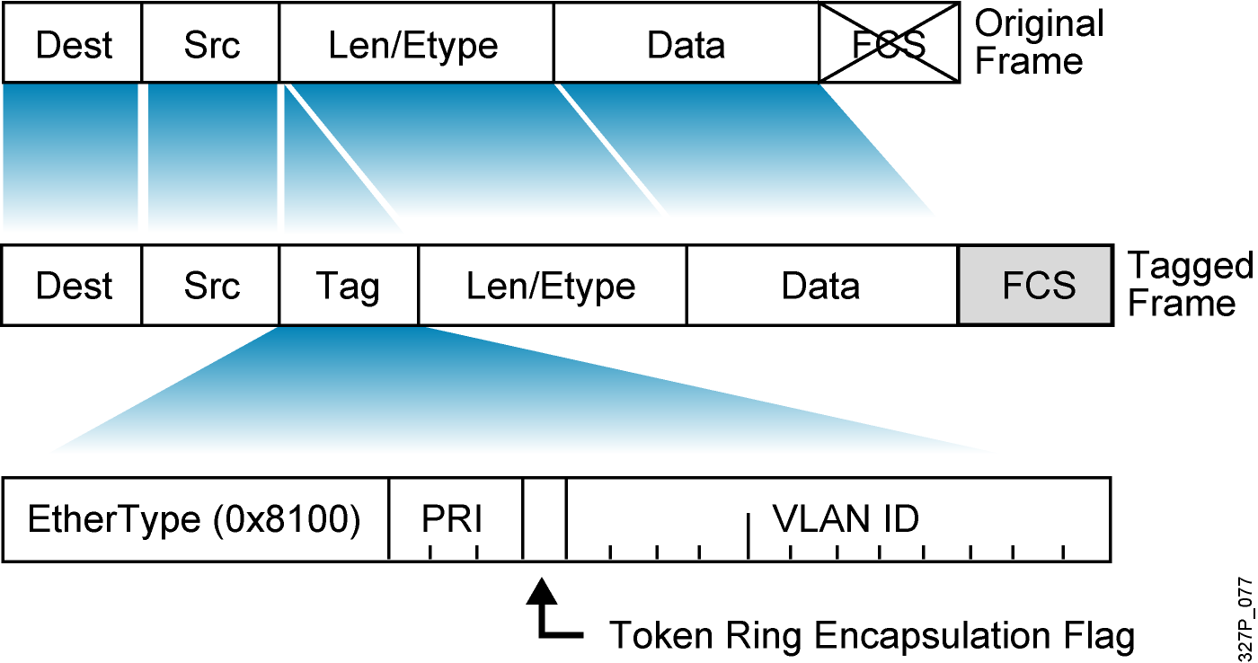
IEEE 802.1Q
Frame check sequence

Slide 15
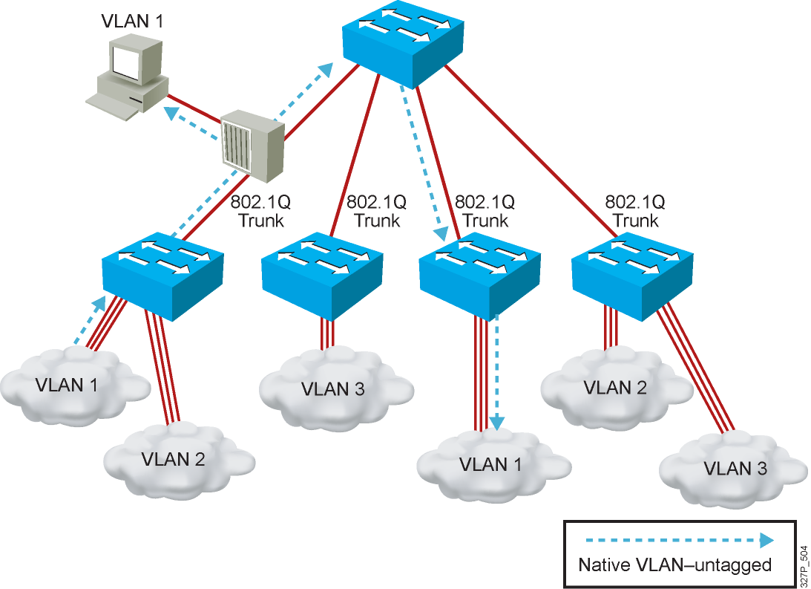
Understanding Native VLANs
All "un-tagged" traffic moves across the Native VLAN

Slide 16
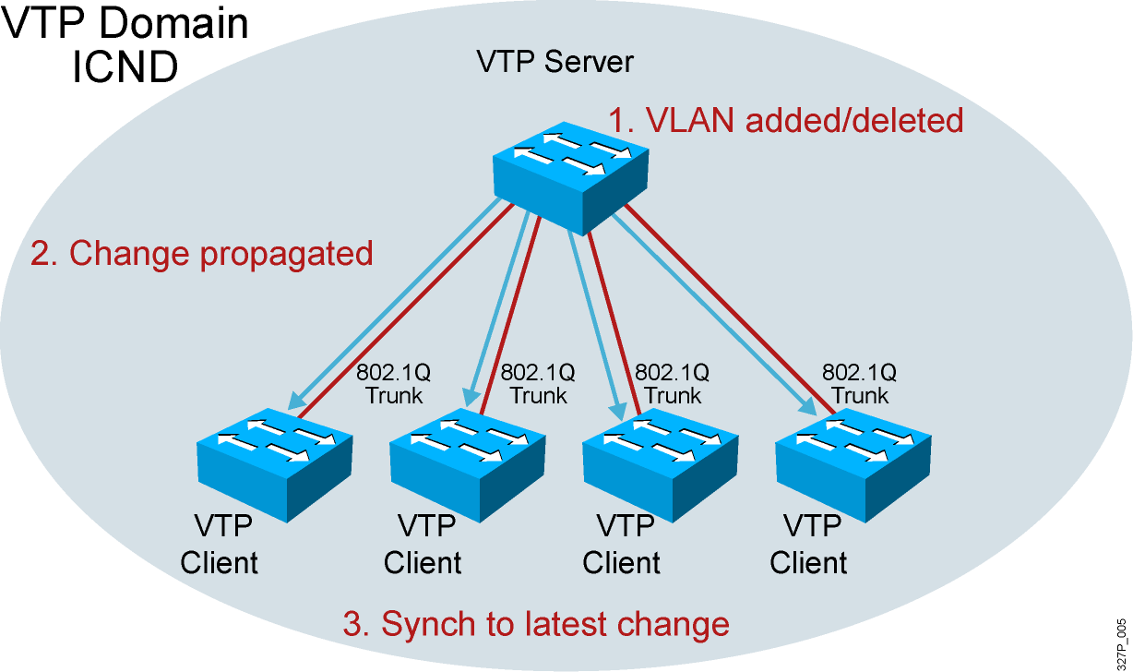
VTP Features

Slide 17
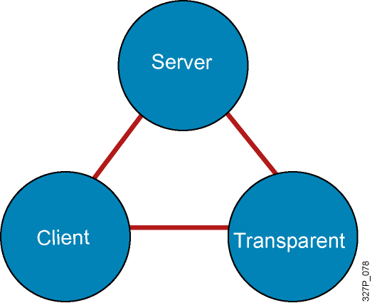
VTP Modes
Create VLANs
Modify VLANs
Delete VLANs
Sends and forwards advertisements
Synchronizes
Cannot create, change, or delete VLANs
Sends and forwards advertisements
Synchronizes
Create local VLANs only
Modify local VLANs only
Delete local VLANs only
Forwards advertisements
Does not synchronize
Notes:
Emphasize: Default VTP mode on the Catalyst switches is server. Be careful when adding new switches into an existing network. This is covered in more detail later.

Slide 18
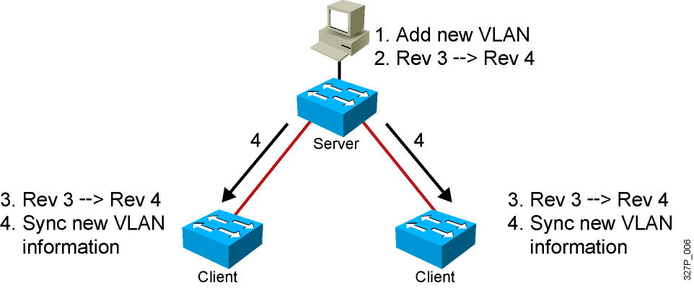
VTP Operation
VTP advertisements are sent as multicast frames.
VTP servers and clients are synchronized to the latest revision number.
VTP advertisements are sent every 5 minutes or when there is a change.
Notes:
Layer 2 of 2
Emphasize: The latest revision number is what the switches will synchronize to.

Slide 19
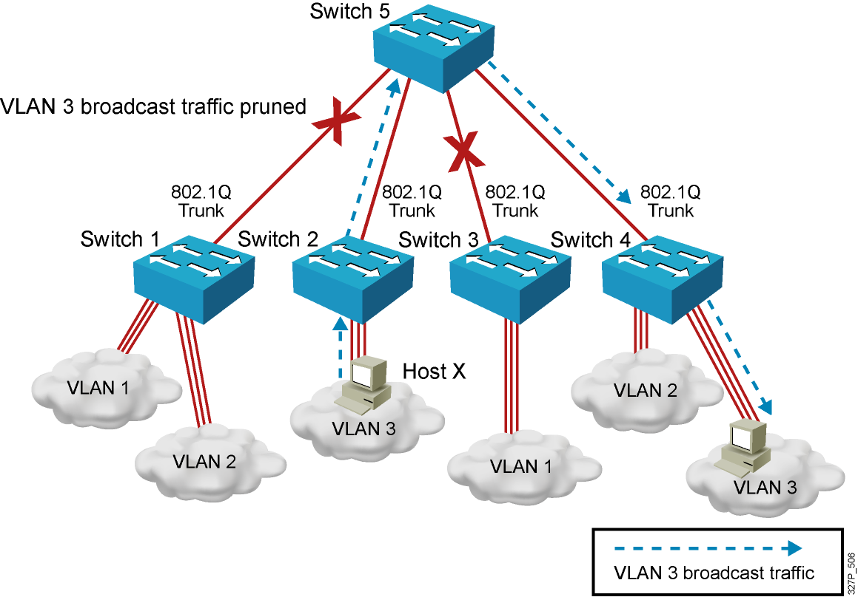
VTP Pruning

Slide 20
Configuring VLANs and Trunks
Configure and verify VTP.
Configure and verify 802.1Q trunks.
Create or modify a VLAN on the VTP server switch.
Assign switch ports to a VLAN and verify.
Execute adds, moves, and changes.
Save the VLAN configuration.

Slide 21
VTP Configuration Guidelines
VTP defaults for the Cisco Catalyst switch:
VTP domain name: None
VTP mode: Server mode
VTP pruning: Enabled or disabled (model specific)
VTP password: Null
VTP version: Version 1
A new switch can automatically become part of a domain once it receives an advertisement from a server.
A VTP client can overwrite a VTP server database if the client has a higher revision number.
A domain name cannot be removed after it is assigned; it can only be reassigned.
Notes:
Notes: All switches in a VTP domain must run the same VTP version.
The password entered with a domain name should be the same for all switches in the domain. If you configure a VTP password, the management domain will not function properly if you do not assign the management domain password to each switch in the domain.
A VTP version 2-capable switch can operate in the same VTP domain as a switch running VTP version 1, provided version 2 is disabled on the version 2-capable switch (version 2 is disabled by default).
Do not enable VTP version 2 on a switch unless all of the switches in the same VTP domain are version 2-capable. When you enable version 2 on a switch, all of the version 2-capable switches in the domain must have version 2 enabled. If there is a version 1-only switch, it will not exchange VTP information with switches with version 2 enabled.
If there are Token Ring networks in your environment, you must enable VTP version 2 for Token Ring VLAN switching to function properly.
Enabling or disabling VTP pruning on a VTP server enables or disables VTP pruning for the entire management domain.
In the lab, all the switches are set to VTP transparent mode.

Slide 22
Creating a VTP Domain
SwitchX# configure terminal
SwitchX(config)# vtp mode [ server | client | transparent ]
SwitchX(config)# vtp domain domain-name
SwitchX(config)# vtp password password
SwitchX(config)# vtp pruning
SwitchX(config)# end
Notes:
Layer 2 of 2
Note: The two commands shown in the slide can also be combined into one command:
vtp domain switchlab transparent

Slide 23
VTP Configuration and Verification Example
SwitchX(config)# vtp domain ICND
Changing VTP domain name to ICND
SwitchX(config)# vtp mode transparent
Setting device to VTP TRANSPARENT mode.
SwitchX(config)# end
SwitchX# show vtp status
VTP Version : 2
Configuration Revision : 0
Maximum VLANs supported locally : 64
Number of existing VLANs : 17
VTP Operating Mode : Transparent
VTP Domain Name : ICND
VTP Pruning Mode : Disabled
VTP V2 Mode : Disabled
VTP Traps Generation : Disabled
MD5 digest : 0x7D 0x6E 0x5E 0x3D 0xAF 0xA0 0x2F 0xAA
Configuration last modified by 10.1.1.4 at 3-3-93 20:08:05
SwitchX#
Notes:
240, 197, 102

Slide 24
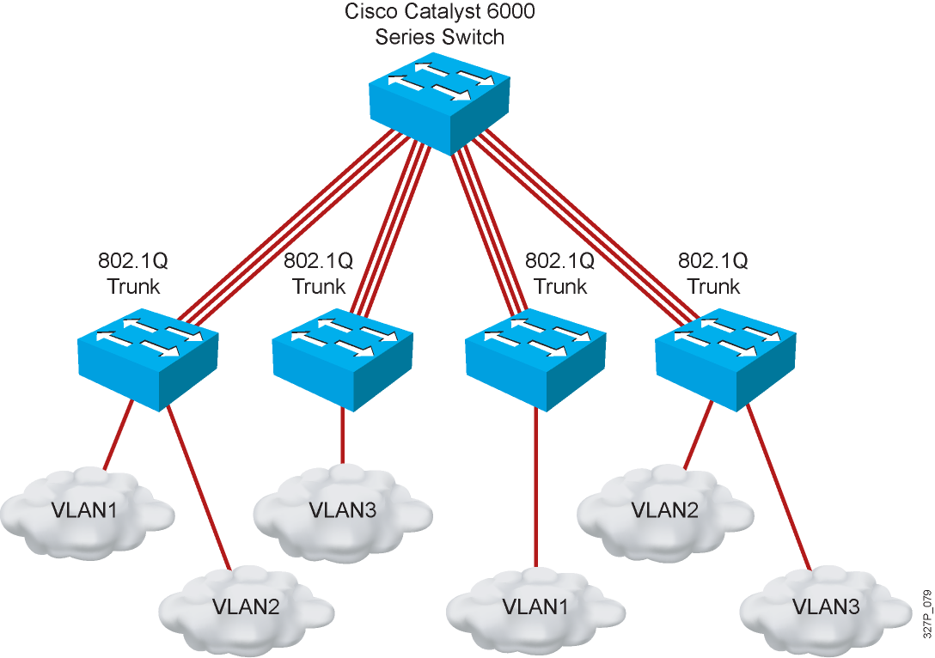
802.1Q Trunking Issues
Make sure that the native VLAN for an 802.1Q trunk is the same on both ends of the trunk link.
Note that native VLAN frames are untagged.
A trunk port cannot be a secure port.
All 802.1Q trunking ports in an EtherChannel group must have the same configuration.

Slide 25
Configuring 802.1Q Trunking
SwitchX(config-if)#
switchport mode {access | dynamic {auto | desirable} | trunk}
Configures the trunking characteristics of the port
SwitchX(config-if)#
switchport mode trunk
Configures the port as a VLAN trunk

Slide 26
Configuring 802.1Q Trunking
c2600(config)# int fastEthernet 0/0.2
c2600(config-subif)# encapsulation isl 2
(hay bằng dot1q)
c2600(config-subif)#encapsulation dot1Q 2

Slide 27
Verifying a Trunk
SwitchX# show interfaces interface [switchport | trunk]
SwitchX# show interfaces fa0/11 switchport
Name: Fa0/11
Switchport: Enabled
Administrative Mode: trunk
Operational Mode: down
Administrative Trunking Encapsulation: dot1q
Negotiation of Trunking: On
Access Mode VLAN: 1 (default)
Trunking Native Mode VLAN: 1 (default)
. . .
SwitchX# show interfaces fa0/11 trunk
Port Mode Encapsulation Status Native vlan
Fa0/11 desirable 802.1q trunking 1
Port Vlans allowed on trunk
Fa0/11 1-4094
Port Vlans allowed and active in management domain
Fa0/11 1-13
Notes:
Layer 2 of 2
Note: The Catalyst 1900,at the time of the beta, only supports ISL trunking. It does not support 802.1Q trunking.

Slide 28
VLAN Creation Guidelines
The maximum number of VLANs is switch-dependent.
Most Cisco Catalyst desktop switches support 128 separate spanning-tree instances, one per VLAN.
VLAN 1 is the factory default Ethernet VLAN.
Cisco Discovery Protocol and VTP advertisements are sent on VLAN 1.
The Cisco Catalyst switch IP address is in the management VLAN (VLAN 1 by default).
If using VTP, the switch must be in VTP server or transparent mode to add or delete VLANs.
Notes:
Note: In the ICND lab, all the switches and routers are in VLAN1. The core server and the core router are in multiple VLANs. Each workgroup PC is on an unique VLAN.

Slide 29
Adding a VLAN
SwitchX# configure terminal
SwitchX(config)# vlan 2
SwitchX(config-vlan)# name switchlab99
Notes:
Layer 2 of 2

Slide 30
Verifying a VLAN
SwitchX# show vlan [brief | id vlan-id || name vlan-name]
SwitchX# show vlan id 2
VLAN Name Status Ports
---- -------------------------------- --------- -------------------------------
2 switchlab99 active Fa0/2, Fa0/12
VLAN Type SAID MTU Parent RingNo BridgeNo Stp BrdgMode Trans1 Trans2
---- ----- ---------- ----- ------ ------ -------- ---- -------- ------ ------
2 enet 100002 1500 - - - - - 0 0
. . .
SwitchX#
Notes:
Layer 2 of 2
Note:
Type: Default is Ethernet (other types are FDDI and Token Ring).
SAID: Is used for FDDI trunking.
MTU: Default is 1500 for Ethernet VLAN.
STP: The 1900 only supports 802.1d Spanning-Tree Protocol. It does not support DEC or IBM Spanning-Tree Protocol. Routers support all three Spanning-Tree Protocol standards.
Other parameters: Used for Token Ring or FDDI VLANs.

Slide 31
Assigning Switch Ports to a VLAN
SwitchX(config-if)#
switchport access [vlan vlan# | dynamic]
SwitchX# configure terminal
SwitchX(config)# interface range fastethernet 0/2 - 4
SwitchX(config-if)# switchport access vlan 2
SwitchX# show vlan
VLAN Name Status Ports
---- -------------------------------- --------- ----------------------
1 default active Fa0/1
2 switchlab99 active Fa0/2, Fa0/3, Fa0/4
Notes:
Layer 2 of 2
Note: In the lab, we will only be configuring static VLAN membership.

Slide 32
Verifying VLAN Membership
SwitchX# show vlan brief
SwitchX# show vlan brief
VLAN Name Status Ports
---- -------------------------------- --------- -------------------------------
1 default active Fa0/1
2 switchlab99 active Fa0/2, Fa0/3, Fa0/4
3 vlan3 active
4 vlan4 active
1002 fddi-default act/unsup
1003 token-ring-default act/unsup
VLAN Name Status Ports
---- -------------------------------- --------- -------------------------------
1004 fddinet-default act/unsup
1005 trnet-default act/unsup
Notes:
Layer 2 of 2
Emphasize: Port 1 = e0/1, ……. AUI = e0/25, A = fa 0/26, B = fa 0/27

Slide 33
Verifying VLAN Membership (Cont.)
SwitchX(config-if)#
show interfaces interface switchport
SwitchX# show interfaces fa0/2 switchport
Name: Fa0/2
Switchport: Enabled
Administrative Mode: dynamic auto
Operational Mode: static access
Administrative Trunking Encapsulation: dot1q
Operational Trunking Encapsulation: native
Negotiation of Trunking: On
Access Mode VLAN: 2 (switchlab99)
Trunking Native Mode VLAN: 1 (default)
--- output omitted ----
Notes:
Layer 2 of 2
Note: In the lab, we will only be configuring static VLAN membership.

Slide 34
Executing Adds, Moves, and Changes for VLANs
When using VTP, the switch must be in VTP server or transparent mode to add, change, or delete VLANs.
When you make VLAN changes from a switch in VTP server mode, the change is propagated to other switches in the VTP domain.
Changing VLANs typically implies changing IP networks.
After a port is reassigned to a new VLAN, that port is automatically removed from its previous VLAN.
When you delete a VLAN, any ports in that VLAN that are not moved to an active VLAN will be unable to communicate with other stations.

Slide 35
Summary
A poorly designed network has increased support costs, reduced service availability, and limited support for new applications and solutions.
VLANs provide segmentation and organizational flexibility.
Ethernet trunks carry the traffic of multiple VLANs over a single link and allow you to extend VLANs across an entire network.
VTP is a Layer 2 messaging protocol that maintains VLAN configuration consistency.

